Slide 1

Email Security
Carl Williams
CSC335-Fall2021

Slide 2
Overview
How They Work
Types of Encryption
What Makes Encrypted Emails Secure?
Outlook
Google
Email Security Solutions
Issues

Slide 3
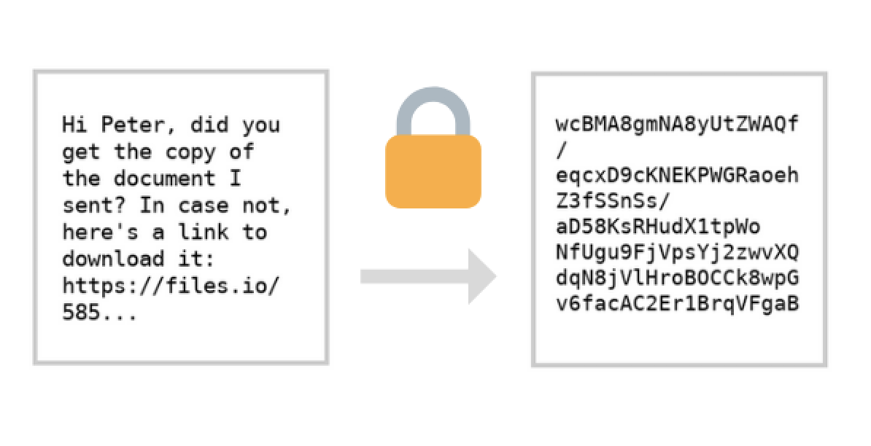
How They Work
Sender:
Finds public key for recipient
Encrypts the message
Sends the message
Recipient:
Decrypts the message
Authentication
Sender signs the message
Recipient receives public key and verifies signature
Website: https://zapier.com/blog/secure-email/

Slide 4
Overview
How They Work
Types of Encryption
What Makes Encrypted Emails Secure?
Outlook
Google
Email Security Solutions
Issues

Slide 5

Types of Encryption
TLS Encrypted Email:
Encrypts email in transit to the recipient, stopping it from being intercepted.
Its easy on the sender and receiver because no extra steps are involved
Receiver isn’t aware that emails are encrypted
Encrypted PDF:
Attachments are encrypted (PDF, Office, or ZIP files)
Can be accessed offline or via password
Can’t stop emails from being forwarded
Web Portal Encryption:
Delivered via a secure webpage, Recipient has to sign in to view the encrypted messages.
Fully encrypted and easy to use
Can add read receipts or a password, and can remove forwarding
Website: https://www.hp.com/us-en/shop/tech-takes/what-are-different-types-of-encryption

Slide 6
Overview
How They Work
Types of Encryption
What Makes Encrypted Emails Secure?
Outlook
Google
Email Security Solutions
Issues

Slide 7
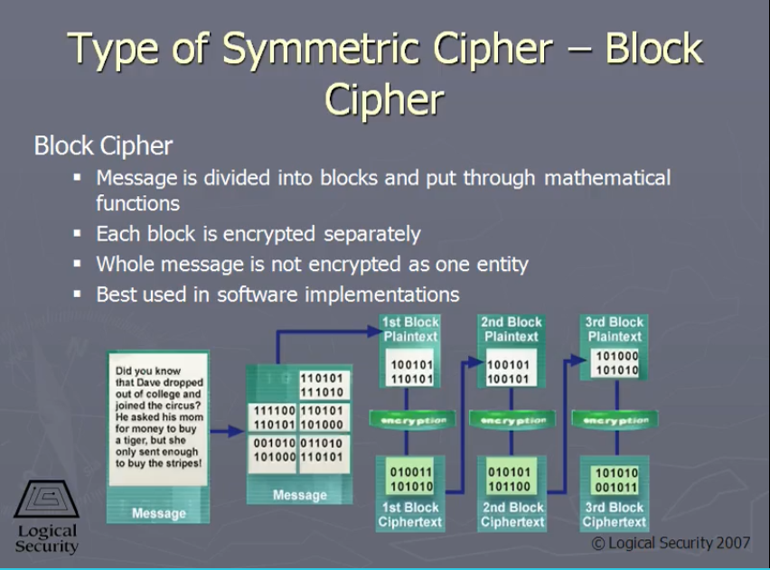
What Makes Encrypted Emails Secure?
Cryptography, this makes it so no one can read the email without knowing the public key
Types:
Symmetric cipher are used to encrypt the data. They are designed to scramble data, making it almost impossible to discover the key. The only way to discover it is to try all possible keys.
Privacy of the symmetric and private keys. One issue here is trying to ensure the keys generated from the software are random. Now, most computers come with a special hardware instruction for producing random bits.
Website: https://www.oreilly.com/library/view/sscp-video-course/9780789741943/i35.html

Slide 8
Overview
How They Work
Types of Encryption
What Makes Encrypted Emails Secure?
Outlook
Google
Email Security Solutions
Issues

Slide 9
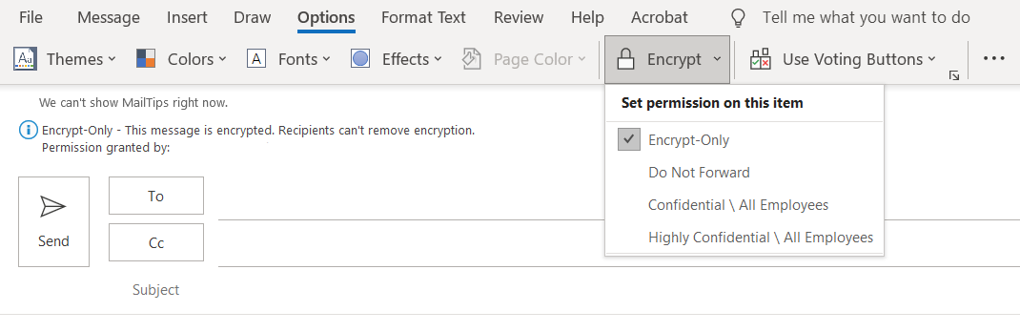
Outlook
Offers S/MIME encryption. To use S/MIME encryption, the sender and recipient must have a mail application that supports the S/MIME standard.
Secure/Multipurpose Internet Mail Extensions (S/MIME) is a widely accepted protocol for sending digitally signed and encrypted messages.
S/MIME offers:
Encryption: Protects the content of email messages.
Digital signatures: Verifies the identity of the sender of an email message.

Slide 10
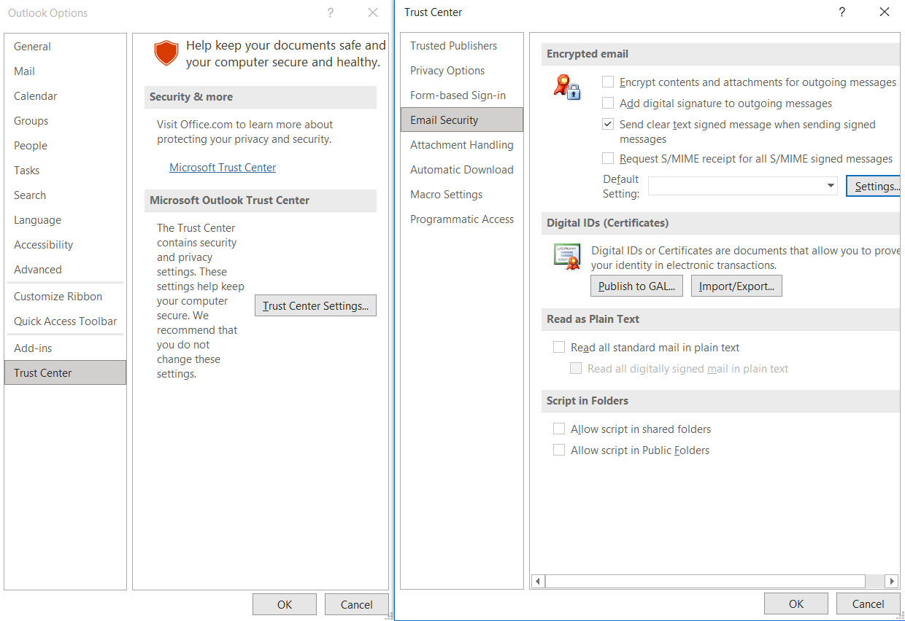
Outlook
Notes:
File > Options

Slide 11
Overview
How They Work
Types of Encryption
What Makes Encrypted Emails Secure?
Outlook
Google
Email Security Solutions
Issues

Slide 12

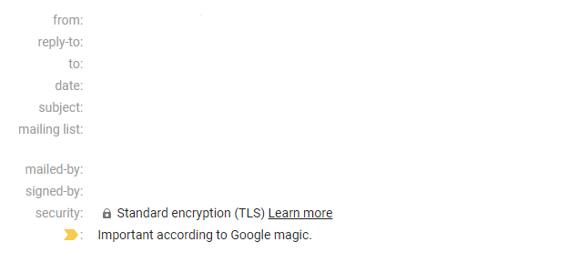
Google
Google uses Gmail for emails. Most emails include standard encryption but only when the other email provider supports TLS encryption.
This works for most messages. Transport Layer Security (TLS) is used for messages exchanged with other email services who don't support S/MIME.
TLS protects a lot of the data that gets transmitted online but not all of it. It’s well-know for securing the data that travels between a web browser and website via HTTPS.

Slide 13
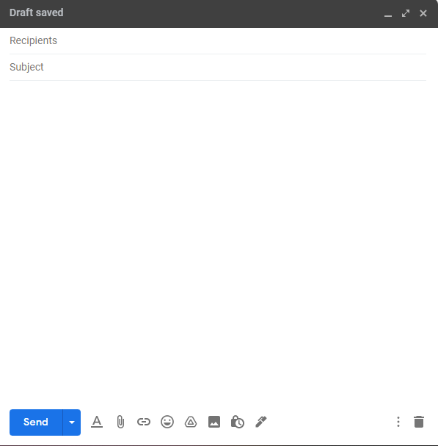
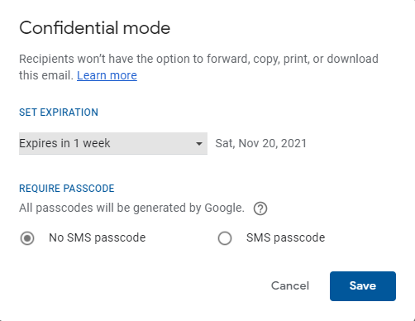
Google

Slide 14
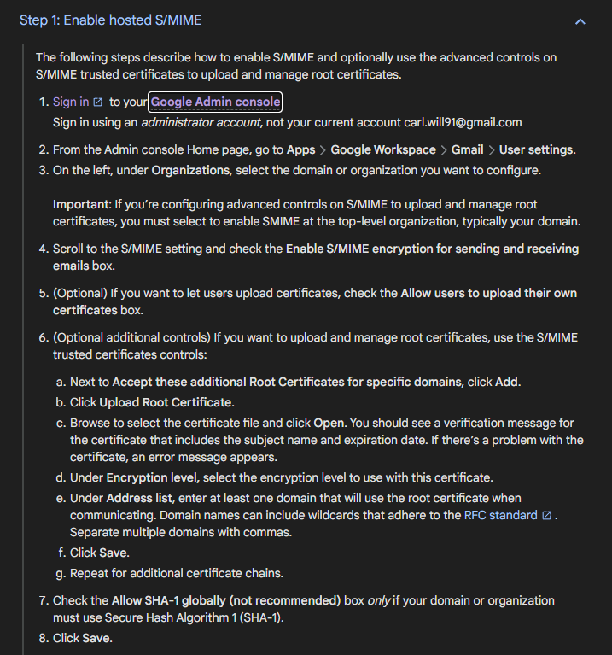
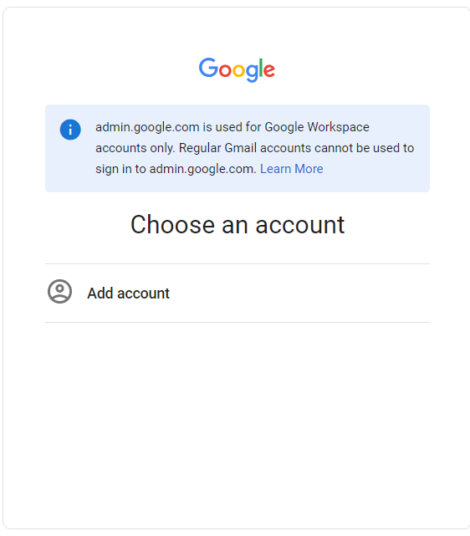
Google

Slide 15
Overview
How They Work
Types of Encryption
What Makes Encrypted Emails Secure?
Outlook
Google
Email Security Solutions
Issues

Slide 16
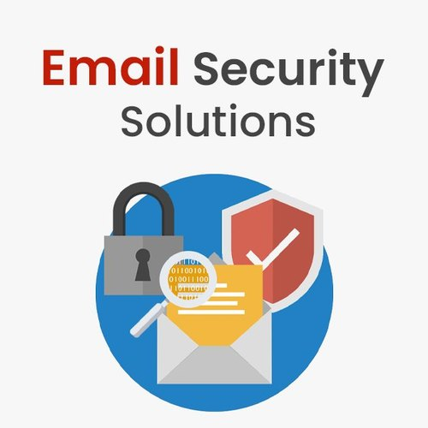
Email Security Solutions
Secure Email Gateway (SEG) is a device or software used for email monitoring that are being sent and received. It prevents unwanted emails that contain phishing attacks, spam, malware, or fraudulent content.
Domain-based Message Authentication Reporting & Conformance (DMARC) uses SPF and DKIM to determine authenticity of emails, making it easier for ISPs to prevent malicious emails.
Sender Policy Framework (SPF) allows you to specify which email servers are legitimate servers for your domain.
DomainKey Identified Mail (DKIM) allows you to attach a domain key signature to your outgoing mail. Then the receiving server either accepts or rejects the mail after it tries to verify the key.
Website: https://www.indiamart.com/premware-services/security-solutions.html

Slide 17
Overview
How They Work
Types of Encryption
What Makes Encrypted Emails Secure?
Outlook
Google
Email Security Solutions
Issues

Slide 18
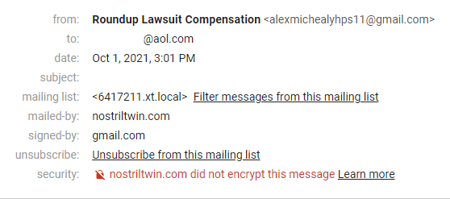
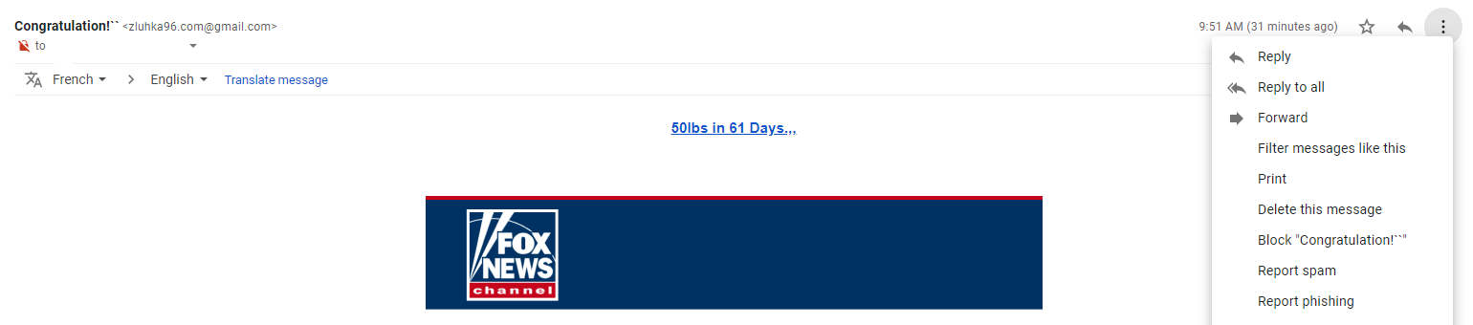
Issues
Not all emails are secure
We don’t always ensure a message, link, or attachment is secure before we open them
People assume the spam folder will catch all unwanted emails

Slide 19
Reference
Orman, H. (2015). Encrypted Email The History and Technology of Message Privacy (1st ed. 2015.). Springer International Publishing. https://doi.org/10.1007/978-3-319-21344-6
Email Gateway. Proofpoint. 4Nov2021. https://proofpoint.com/us/threat-reference/email-gateway
Set up SPF and DKIM records. Rackspace. 6Nov2021. https://docs.rackspace.com/support/how-to/set-up-spf-and-dkim-records/
Google Help Center. https://support.google.com/a/answer/6374496?hl=en#zippy=
Microsoft Support. https://support.microsoft.com/en-us/office/encrypt-email-messages-373339cb-bf1a-4509-b296-802a39d801dc

